Slide 1



Project phase 1

Slide 2
Summary
Microsoft is expanding its business in movie and film making industry. The task is to conduct a research using data analysis and find the types of movies currently in demand. The top three genres are adventure, action and comedy.

Slide 3
Outline
Business Problem
Data
Methods
Results
Conclusions

Slide 4
Business Problem
The industry in movie and film making is competitive. It is lead by companies like Netflix, Disney and Stan. Microsoft is an established company in technology and computing machines. While it may seem that technology and movie making are related, the operations for the industries are completely different. Consumers may also have expectations that Microsoft will deliver high quality movies because of their reputation in technology and computing.

Slide 5
Data
The data sets used in the project are three CSV files. The files are merged to create a complete data frame and start data analysis.
Data’s 1 and 2 have a common primary key available for merging.
Data 3 requires a primary key to be created to complete the merging of data sets.

Slide 6
Methods
The first part is importing the libraries in the Jupyter notebook such as Pandas, NumPy, Matplotlib, Seaborn and uploading the CSV files.
Next is merging the data sets 1 and 2 with their primary keys and creating a primary key for data 3 to complete the merging of data sets. Once the data sets are merged, it is essential to check key information like null values, duplicates, and statistics.
The final step is to present the data by using visualizations in the form of graphs and statistics.

Slide 7
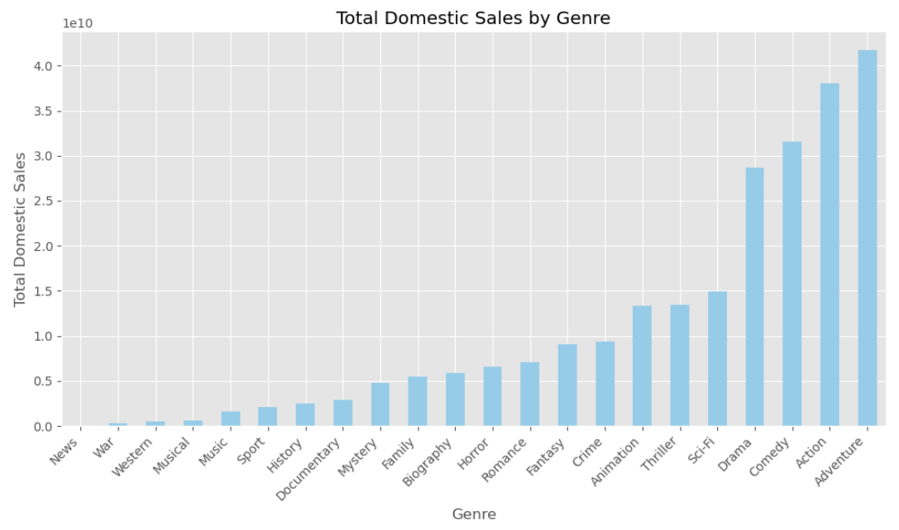

Results
The top 3 genres in domestic sales are adventure, action and comedy.

Slide 8
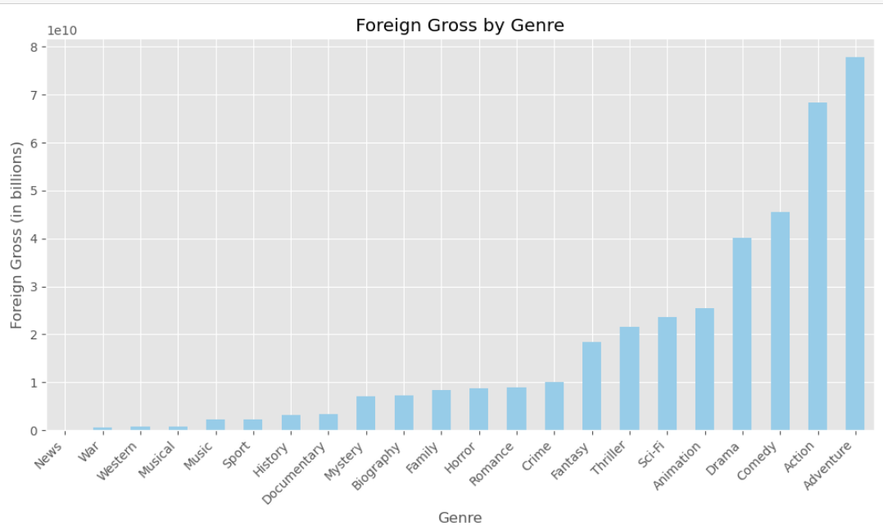
RESULTS
The top 3 genres in foreign gross are adventure, action and comedy.

Slide 9
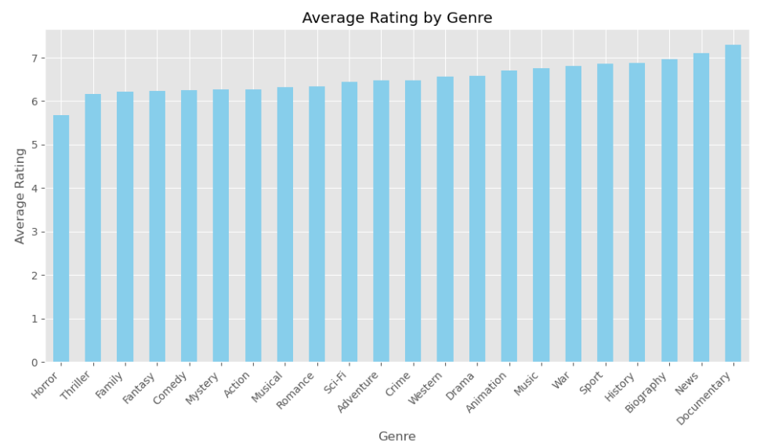
Results
In average rating, the top 3 genres are documentary, news and biography.

Slide 10
Conclusions
In conclusion, the top three movie genres which Microsoft can invest are adventure, action and comedy.
Microsoft can leverage in the market with its technological advancement to produce high quality of films.
Microsoft must upskill its employees or hire people specializing in producing films to compete in the market.

Slide 11
Thank You!
Email: ben_valencia12@yahoo.com.au
GitHub: @ben valencia
LinkedIn: https://www.linkedin.com/in/benvalencia/

